Slide 1
Xamarin KegID

Slide 2
Agenda
Prerequisite for Xamarin development
Pattern and framework
Local DB and other component
Architecture flow of Xamarin App
Functionality of Xamarin app
Xamarin App UI standard
TBD
Q&A

Slide 3
Prerequisite for Xamarin development
1. Installing Xamarin on Windows
Xamarin can be installed as part of a new Visual Studio 2019 installation, with the following steps:
2. Installing Xamarin on macOS
Installing Xamarin on macOS Step-by-step instructions

Slide 4
Pattern and framework
Xamarin form : Is using MVVM (Model-View-ViewModel) Pattern for building kegID application
Xamarin form : Is using Prism framework for binding UI and ViewModel
Link to Prism Framework Documentation

Slide 5
Local DB and other component
Realm is being used for Local data store
Link to Realm Documentation
Components:
Acr.UserDialogs | CarouselView.FormsPlugin
LinkOS_Xamarin_SDK | Microsoft.AppCenter.Analytics
Scandit.BarcodePicker.Unified | Xamarin.Essentials
Plugin.CrossPlatformTintedImage | Xam.Plugins.Settings
Xamarin.FFImageLoading.Forms

Slide 6
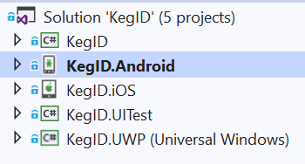
Architecture flow of Xamarin App
Xamarin App Structure
.NET Standard Library for Sharing Code
Android App
iOS App
Unit Test
UWP App

Slide 7
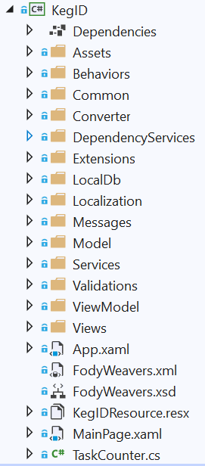
Architecture flow of Xamarin App
Xamarin App Architecture
List View selection & Text change Event handler
AppSetting, HttpClient & Generic Code
Converter BoolToVisibility and so on
Accessing Platform specific code
Realm Db Manager
Culture Info & Resources text utility
All the property classes for binding UI
Service Call, Service API for Zebra Printer and other interface
Business Logic
UI (end user display)
Initial App setting & Resources
Static Resources
Main Landing Page
BG Services

Slide 8
Functionality of Xamarin app
Move
Create Manifest
Add New Partner
Scan Kegs
Save Draft Manifest In Local Db
Manifest Detail(Sharing option as PDF, etc..)
Manifest list once you click on Manifest detail
Zebra Printer with ZPL setting for Move Manifest
Scandit SDK Integrated

Slide 9
Functionality of Xamarin app
Fill
Fill Kegs
Add Pallet
Add batch
Scan Barcode
Manifest Detail(Sharing option as PDF, etc..)
Manifest list once you click on Manifest detail

Slide 10
Functionality of Xamarin app
Palletize
Build Pallet
Kegs Scan
Pallet Detail with (Sharing Option as PDF, etc..)
Manifest list once you click on manifest detail

Slide 11
Functionality of Xamarin app
Maintain
Maintain selection
Scan Barcode
Maintain Detail Screen
Maintain list once you click on detail screen

Slide 12
Functionality of Xamarin app
Dashboard
Manifest
Show the submitted Manifest, Draft, Queue
Stock | Avg Cycle Time
Empties | At Risk Kegs
In Use
Total

Slide 13
Functionality of Xamarin app
Dashboard
Pallet
Search Pallet By(Pallet Barcode, Barcode, Location Created and From to To date)
Display list of Pallets
Edit Pallet will take you to build pallet
Move Pallet will take you to create manifest

Slide 14
Functionality of Xamarin app
Dashboard
Partners
Partners List
Once you click particular Partner will take you to Partner Info
Once you click No.of Kegs from Partner Info it will take you Kegs list
Once you click particular Kegs will take you to Kegs status
Show maintenance Alert with alert icon
Click on alert Icon will show pop up with Maintenance Performed
Current Location will show Map with Pin
Move Keg will take you Create Manifest with selected value
Add Alert
Remove alert
Show the list of maintenance Performed
Edit Partners will take you to Add partner with selected value
Send Kegs will take you to Create Manifest

Slide 15
Functionality of Xamarin app
Dashboard
Kegs
Search Kegs
Show the list of Kegs
Once click on Particular Kegs will take you to Kegs status
Bulk Update

Slide 16
Functionality of Xamarin app
Dashboard
Settings
Refresh
Will refresh the Dashboard Data
Printer Settings
Print Every manifest (true, false)
Print Every Pallet (true, false)
Pallet label copies(No. of copies)
Beeps On Valid scans (true, false)
Zebra Printer
Bluetooth (On, Off)
If you select Bluetooth one the it will tell you to select Printer
Else you can put IP/Host and Port
Test Printing Option

Slide 17
Xamarin App UI standard
Existing iOS
Xamarin Android
Xamarin iOS
We following UI standard
for Xamarin App
KegID App Standard.docx

Slide 18
TBD
Offline Online syncing
Some of the functionality needs to incorporate which there in iOS App
Full unit testing needs to cover

Slide 19
Questions?

